Slide 1

Predicting Stock Prices with Regression Models
This project aims to predict next-day stock prices. We use historical NIFTY 50 data from Kaggle. Our goal is to build, visualize, and evaluate a robust regression model.

Slide 2



Introduction
1
Stock Price Prediction
2
Regression Model Importance
A significant challenge in financial markets.
Key for quantitative analysis and forecasting.
3
Project Goals
Develop and validate a predictive methodology.

Slide 3
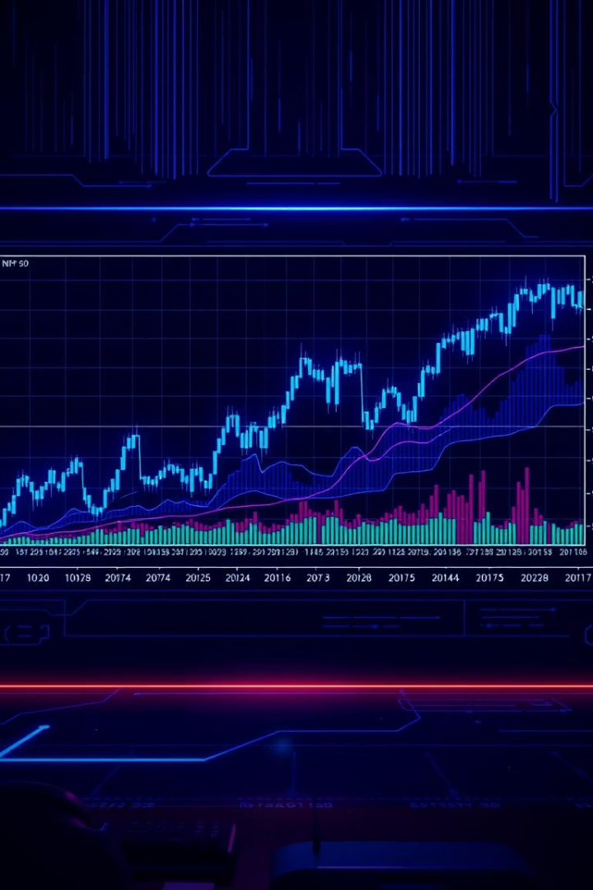

Dataset Overview
Source
NIFTY 50 Stock Market Data (Kaggle)
Time Span
Jan 1, 2000 to Dec 31, 2023
Key Features
Open, High, Low, Close, Volume
Data Volume
24 years of daily stock data
The NIFTY 50 dataset provides extensive historical financial data. It includes essential metrics like Open, High, Low, Close, and Volume for 24 years. This rich dataset forms the foundation for our predictive model.

Slide 4





Data Preprocessing
Handling Missing Values
Imputation using mean or median methods.
Outlier Detection
Using IQR method and Z-score analysis.
Feature Scaling
Standardization and Min-Max scaling (0-1).
Data preprocessing is crucial for model accuracy. We address missing values and outliers to ensure data quality. Feature scaling normalizes data, preventing bias towards larger values.

Slide 5









Feature Engineering
Lagged Variables
Moving Averages
Previous day's price and volume.
5-day, 20-day, and 50-day averages.
Percentage Change
Technical Indicators
Daily price changes for momentum.
RSI and MACD for market signals.
Feature engineering transforms raw data into predictive signals. Lagged variables capture short-term dependencies. Moving averages provide trend insights. Technical indicators reveal market sentiment, while percentage change highlights daily momentum.

Slide 6

Regression Model Selection
Linear Regression
Polynomial Regression
Support Vector Regression (SVR)
Random Forest Regression
Simple and interpretable.
Captures non-linear relationships.
Effective for high-dimensional data.
Robust and handles complex interactions.
We consider multiple regression models for their diverse strengths. Linear regression offers simplicity, while polynomial addresses curvature. SVR excels in complex datasets. Random Forest provides robustness and handles interactions well, offering diverse approaches for accurate prediction.

Slide 7
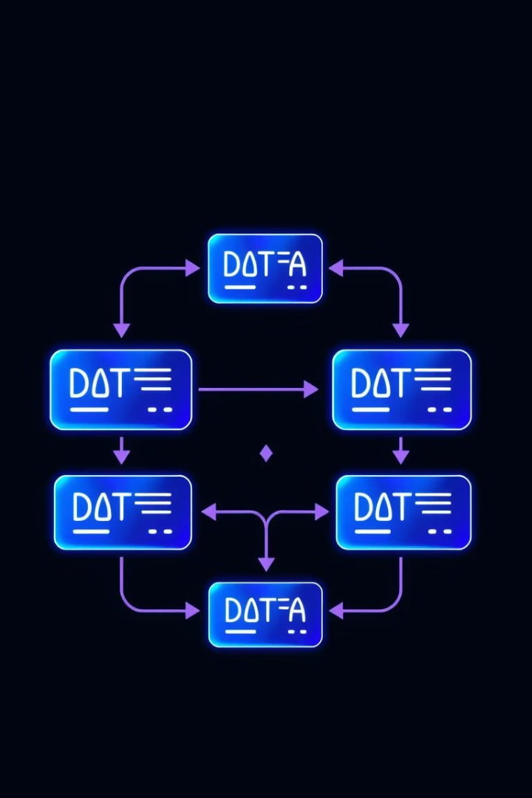
Model Training and Validation
Splitting Data
80% for training, 20% for validation.
Cross-Validation
K-fold (K=5 or 10) for robust evaluation.
Hyperparameter Tuning
Grid search and random search optimization.
Model training and validation are crucial for reliable predictions. We split data to ensure unbiased evaluation. Cross-validation strengthens model generalizability. Hyperparameter tuning fine-tunes performance for optimal results, ensuring accuracy and stability.

Slide 8
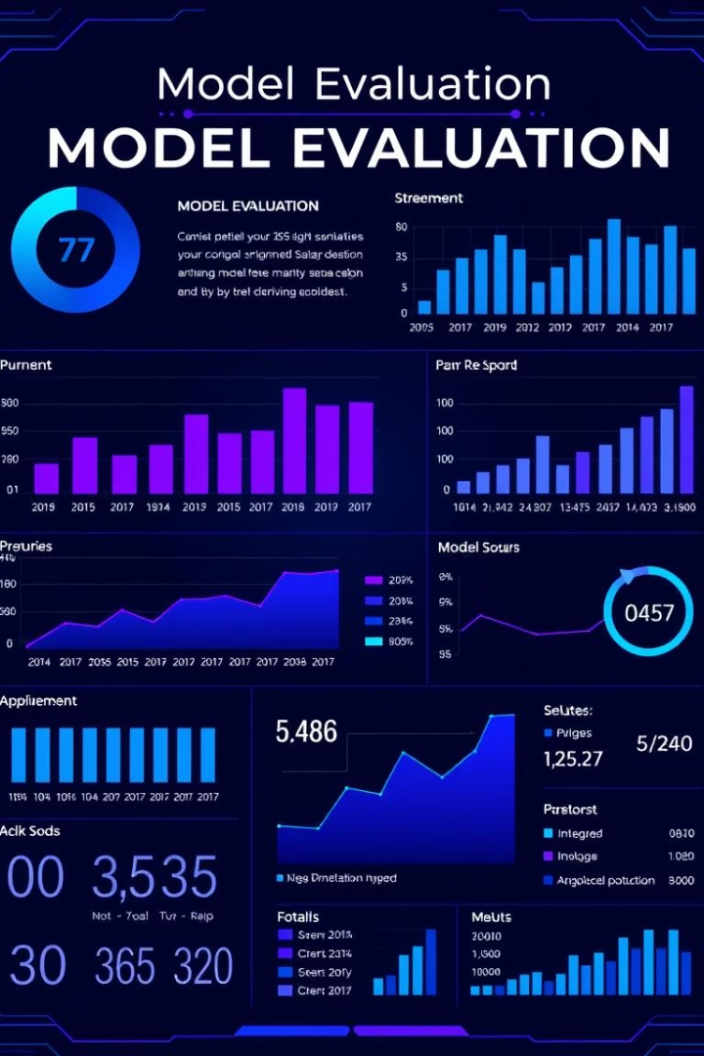
Model Evaluation Metrics
MSE
Mean Squared Error
Average squared difference.
RMSE
Root Mean Squared Error
Square root of MSE, same unit.
MAE
Mean Absolute Error
Average absolute difference.
R-squared
Coefficient of Determination
Proportion of variance explained.
Evaluating our model relies on robust metrics. MSE and RMSE quantify prediction errors. MAE provides a direct measure of average error. R-squared indicates how well the model explains data variability, collectively offering a comprehensive performance assessment.

Slide 9
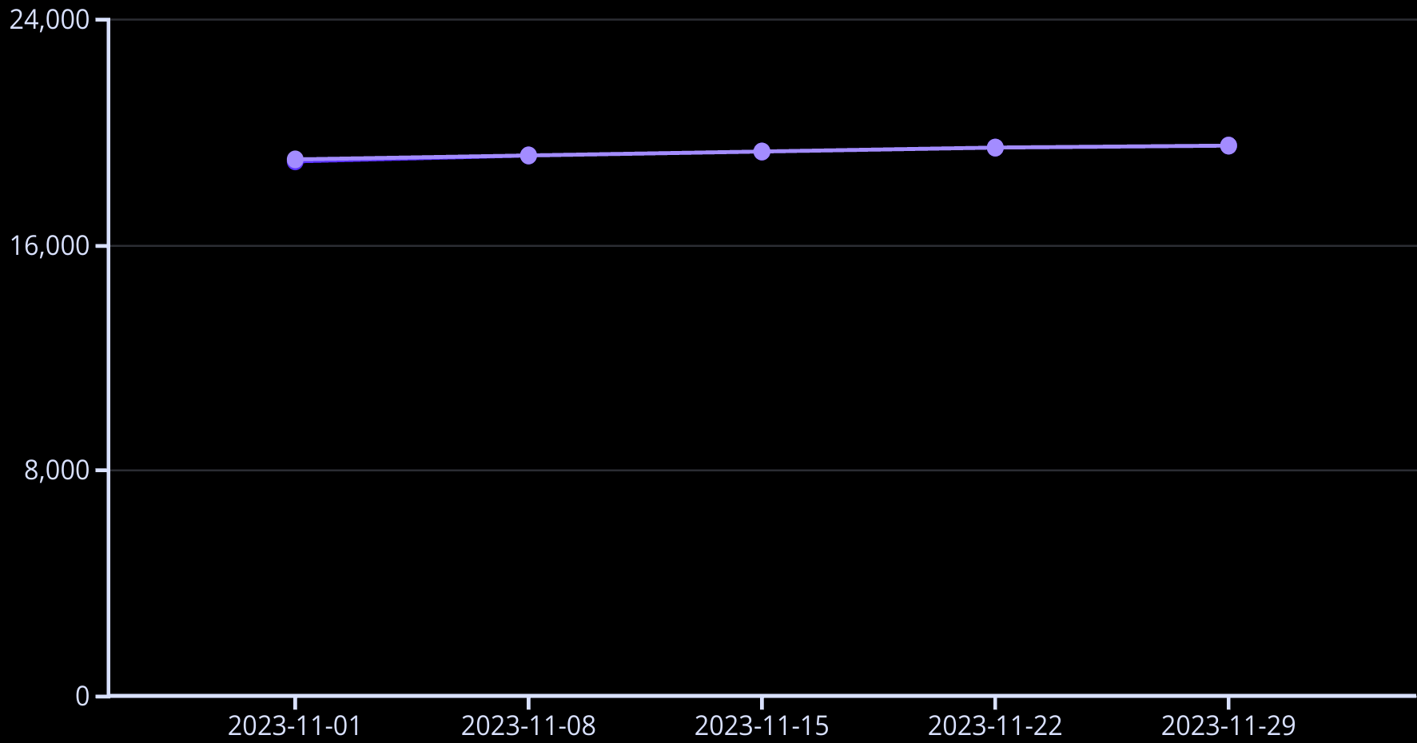
Visualization: Actual vs. Predicted Prices
Actual Price
Predicted Price
The line chart illustrates actual vs. predicted stock prices. It highlights how well our model tracks market movements over time. Residual analysis will further show error distribution for refined accuracy.

Slide 10
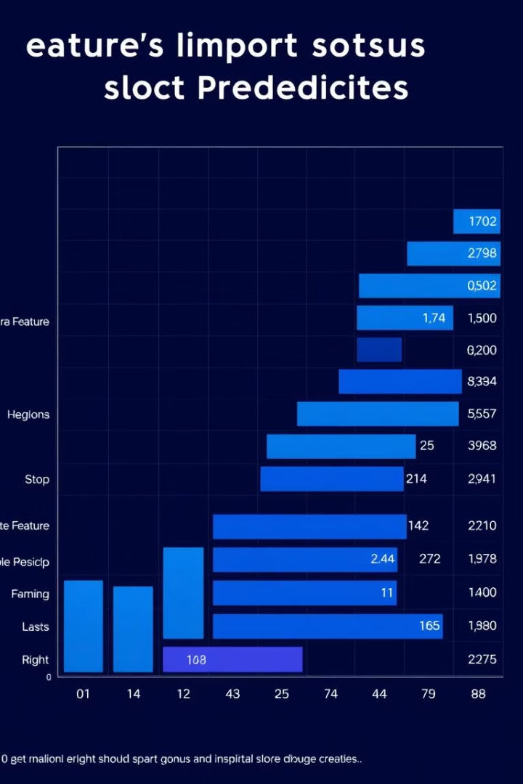
Visualization: Feature Importance
Bar Plot
Key Drivers
Visualizes feature importance scores directly.
Identifies the most influential stock price factors.
Feature Selection
Guides optimization based on importance ranks.
A bar plot visually presents feature importance scores. It provides insights into which variables significantly drive stock price predictions. This visualization informs feature selection and improves model efficiency.

